Slide 1
AEAJ workshop in Rome on 4 – 5 October 2012
Case study “Mountain bike downhill course”
Comments to the questions

Slide 2
Judicial review restrained ?
Opinion of Advocate General Kokott
C-127/02 “Waddenzee”
Para 109
C- 241/08 „Commission v France“
Para 30
Certain margin of discretion of the public
authority
German doctrine (Federal Administrative
Court): No discretion (full control)

Slide 3
Site adversely affected ?
Site‘s conservation objectives affected
Loss of 1000 m² insignificant?
(No legal provisions in Germany)
Guidelines (Experts Commission)
Threshold if less than 0,1 % of the site
is lost:
Habitat type 6520: 500m2
Habitat type 6230: 250 m²

Slide 4
3. Annulment due to a procedural fault ?
Yes
The interest is to weigh up against the damage
CJEU
C‑304/05, Commission v Italy, para 83
C‑182/10, Marie-Noëlle Solvay and Others,
para 74
The court can not grant dispensation itself

Slide 5
Preconditions met?
Restrictive interpretation of article 6 (4)
Judgement C-182/10, para 73 – 78
Absence of alternative solutions
No condsiderations according
to article 6 (4) subparagraph 2
No considerations according to
article 6 (4) subparapgraph 1

Slide 6
5.Support of an amicable settlement ?
The court can not prevent an agreement of the parties
Principle of party disposition
Promotion of an amicable settlement is at the discretion of the court
Legal or factual incertainty?

Slide 7
6. Kind of an amicable settlement
Withdrawal of the action? No consent of the plaintiff!
Agreement to be recorded with the court? Posssible, but complicated.
The best way:
The defendant imposes the requested conditions for the record of the court,
the oparator declares waiver of legal remedy against the amendmend of the permit,
all partiies declare the dispute settled,
- the court rules on the costs only, according to section161 (2) German Code of Adminsitrative Court Procedure

Slide 8
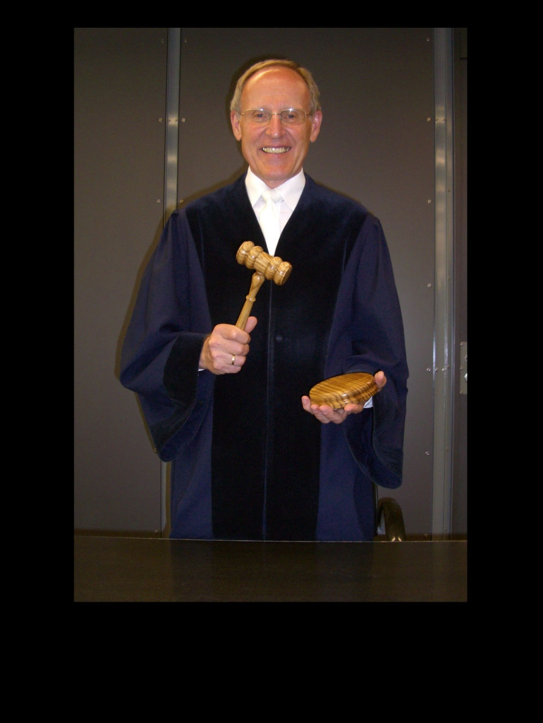
T
The session is closed !

